Slide 1
Intro to Insurance
HOWDEN TIGER

Slide 2
Agenda
Defining Insurance – What is It and Why do People Get It?
Types of Insurance and Parties Involved
Terms
Coverages
Personal Lines vs Commercial Lines
Common Insurance Forms
Typical Exclusions
Examples

Slide 3

Definition
Insurance is a Contract used to Alleviate Financial Risk
“A practice or arrangement by which a company or government agency provides a guarantee of compensation for specified loss, damage, illness, or death in return for payment of a premium.”
Essentially insurance is a means for individuals to pool money together in order to reduce financial risk following an unexpected event.
The policyholder pays an insurance company a small amount – usually monthly – so that if the policyholder incurs a relevant claim, the insurance company is liable for a portion of the bill.

Slide 4
Types of Insurance
Clients of Howden Tiger are Primarily Property and Auto Insurance Companies
Health Insurance
Policyholder is covered in the event of a medical emergency
Life Insurance
Beneficiaries are covered in the event of the policyholder’s death
Disability Insurance
Policyholder is covered for lost income due to injury or illness that prevents them from working
Property Insurance (Homeowners / Renters Insurance)
Policyholder is covered in the event of damage to living space and/or contents
Auto Insurance
Policyholder is covered in the event of damage to automobile
Our Focus

Slide 5
Policy Terms – Property Insurance
R:\01_REFERENCES\CheatSheat_Terms.xlsx
Policy
The contract between the policyholder and insurance company
Location
The actual location(s) of the insured entity
Premium
The price the policyholder pays in exchange for insurance coverage
Claim
Any request or demand for payment under the terms of the insurance policy
Deductible
The potion of a claim the policyholder pays out of pocket
AOP (All Other Perils)
Policies usually have separate deductibles for Hurricane coverage and All Other Peril coverages

Slide 6
Policy Terms – Property Insurance (cont.)
Total Insured Value (TIV)
Cost of replacing the entire insured property
Total Replacement Value (TRV)
Typically the same as TIV, although some clients may report like a PARTOF
Coverage
Protection and benefits provided in an insurance contract
Insured Limit
The maximum amount of money an insurer will pay toward a covered claim
Loss
Ground Up Loss
Total Loss
Gross Loss
Total Loss less Insured Deductibles
Retained Loss
Amount which the policyholder is responsible for – similar to deductible

Slide 7
Policy Terms – Property Insurance (cont.)
Inception Date
The date at which the insurance policy goes into effect
Expiration Date
The date that a policyholder’s insurance coverage ends
Blanket / Site Deductibles
Applies deductibles to a policy’s entire limit
Coverage Deductibles
Applies deductibles to certain coverages
Sublimit
Extra limitations in an insurance policy's coverage of certain losses
Shared / Layered Insurance
Different insurers offer multiple layers of coverage, creating a “tower” of coverage

Slide 8
Coverages
Coverages A, B, C, & D are the Primary Coverage Values
Coverage A – Building Coverage
Applies to structural components of your home: walls, floors, ceiling, etc.
Coverage B – Other Structures Coverage
Applies to structures independent of your home: fencing, detached garages, etc.
Coverage C – Contents Coverage
Applies to possessions inside the home: jewelry, artwork, furniture, etc.
Coverage D – Loss of Use Coverage
Applies when a home is unlivable after a claim: house expenses, food costs, etc.
Coverage E – Personal Liability Coverage
Applies when the homeowner is at fault when negligence has caused property damage or injury
Coverage F – Medical Coverage
Applies when a person is accidentally injured
Our Focus

Slide 9


Personal Lines vs Commercial Lines
Individual vs Business
Personal Lines
Type of property and casualty insurance policy offered to individuals
Typically, one policy covers one location
Commercial Lines
Type of property and casualty insurance policy offered to businesses
Typically, each policy covers multiple locations
Can cover anything ranging from property insurance, auto insurance, workers compensation, and even cyber liability insurance

Slide 10
Common Insurance Forms
HO3 is the Most Common Insurance Form for Homeowners
HO2 – Broad Form
Homeowner’s (named perils only)
HO3 – Special Form
Homeowner’s (all perils not explicitly excluded)
HO4 – Contents Broad Form
Renter’s (tenants)
HO5 – Comprehensive Form
Homeowner’s (most broad coverage)
HO6 – Unit Owners Form
Condo owners
HO7 – Mobile Home
Mobile Homeowners
HO8 – Modified Coverage Form
Homeowner’s (specific named perils)
DP__
Intended for landlords; might include things like “loss of rent coverage”
Can also be used for vacant homes
BOP
Business Owner’s Policy
BPP, BIC, CGL, etc.
Building & Personal Property
Business Income Coverage
Commercial General Liability

Slide 11

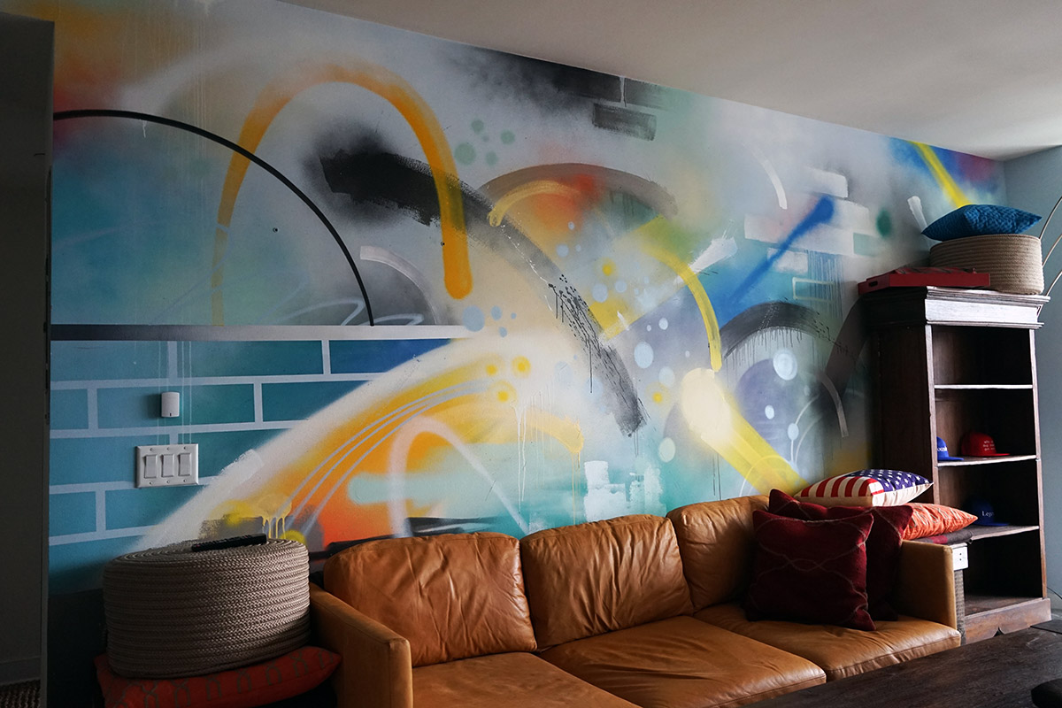

Typical Exclusions
Ordinance or Law
Repairs / updated needed to bring home up to current building standards
Earth Movement
Water Damage
Flooding
Power Failure
Neglect
War
Nuclear Hazard
Intentional Loss

Slide 12
Example Policies
Policy 1 – Single Family Home:
$250,000
Policy 2 – Multiple Buildings:

Slide 13
Example Policies (cont.)
Policy 3 – Sublimits:
Policy 4 – Shared/ Layered Policy:

Slide 14

Example Policy with Loss
Coverage A:
$300,000
Coverage B:
$40,000
Coverage C:
$60,000
Coverage D:
$10,000
Deductible:
2% (of Coverage A)
Premium:
$750
Sample Event Details:
A tornado runs through the policyholder’s neighborhood, causing damage. The following claim is made.
Roof Repairs costing $20,000
Garage Repairs costing $1,000
Flooded Basement Damage costing $2,000
Other Building Damage totaling $60,000
Losses will depend on what kind of insurance the policyholder has
Is flood included?
Are there certain limits?
Ground-Up Loss (Assuming Everything is Covered)
$83,000 = $20,000 + $1,000 + $2,000 + $60,000
Retained Loss (Assuming Everything is Covered)
$6,000 (Losses Exceed the Deductible)
Gross Loss (Assuming Everything is Covered)
$77,000 = $83,000 - $6,000

Slide 15


